Slide 1

CO-OP at UHS!
GREAT OPTIONS,
GREAT OPPORTUNITIES
For more info visit:
www.uhscoop.com

Slide 2

THINKING ABOUT WHAT PATHWAY YOU WANT TO TRY AFTER HIGH SCHOOL ?

Slide 3

How Can Co-op Help You?
Allows you to get “real life” experience in the workplace
Gives you hands-on learning and a chance to “try on” a possible career option
Helps you make decisions about your future

Slide 4
Co-op will also....
Help you find out what it’s really like to work at a job
Show you what career opportunities are out there related to your field of interest
Provide experience and a reference to add to your resume
Satisfy Group 1,2,3 requirements when you earn your co-op Credits

Slide 5

Co-op and Your School Day
Co-op occupies two periods (two credits) on your timetable
Your placement happens during the school day along with your other classes
Experiential learning opportunity for a half day for the entire semester
You can also complete a 4 credit program
(full day)

Slide 6
Sample Timetable
Period 1 – CO-OP
Period 2 – CO-OP
Period 3 – LUNCH
Period 4 – Regular Class
Period 5 – Regular Class
Period 1 – Regular Class
Period 2 – Regular Class
Period 3 – LUNCH
Period 4 – CO-OP
Period 5 – CO-OP
Morning Co-op
Afternoon Co-op

Slide 7
Co-op AND You
Grade 11 or 12 students
Every student is eligible to experience a career of his/her choosing (more or less)
Co-op teachers work with community partners to secure a placement for every student
Co-op teacher visits you regularly during your placement time over the semester

Slide 8
Co-op…How do I sign up?
At course selection time, go online to the Co-operative Education Section of the course calendar in My Pathway Planner
Select the correct co-op course (Gr. 11/12-2 credit or 4 credit), and add it to your course selections
Then.....

Slide 9
Complete the co-op application form by following the link and instructions on My Pathway Planner
You will need to use your GAPPS email to do this. Answer a few questions to fill in a on-line copy of the co-op application. It will be emailed to your GAPPS email account. You can forward your GAPPS to another email.
Then, print the application, have it signed, have the two teacher references completed and submit everything to the Co-op Office Drop Box.
A deadline will be given for submission of your Completed Application and two teacher references.
                VISIT www.uhscoop.com

Slide 10
Frequently Asked Questions
What if I don’t like my placement?
What if Co-op won’t fit into my schedule?
Should I take Co-op in summer school?
How am I evaluated in Co-op?
How do I get to my placement?
Do universities and colleges look at Co-op marks?
Will my placement hire me?
Can I use Co-op hours for community involvement?
What kinds of placements are available?

Slide 11
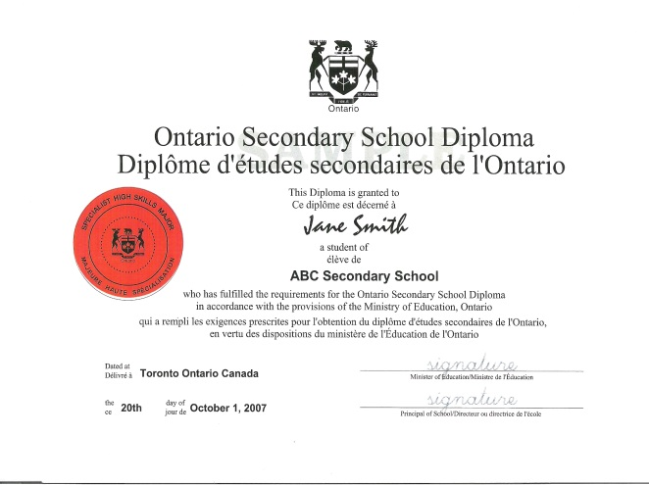
SHSM - Specialist High Skills Major
An Opportunity to:
Focus your learning-Arts & Culture or Business
Coming September 2019- Health and Wellness!!
Get some valuable experience and information (co-op, reach-aheads, certifications, workshops) outside of the regular classroom
Enhance what you already have planned for your future
APPLY at: www.uhscoop.com
Use your GAPPS email

Slide 12

Want to know more?
Drop by Room 215
or....
ASK QUESTIONS RIGHT NOW!

